Slide 1

Module 5
Tree-Based Models
Notes:
Guidelines
Use section headers to chunk content in your presentation.
Use the same style of section header throughout your presentation.
Keep your title to no more than 2 lines.

Slide 2
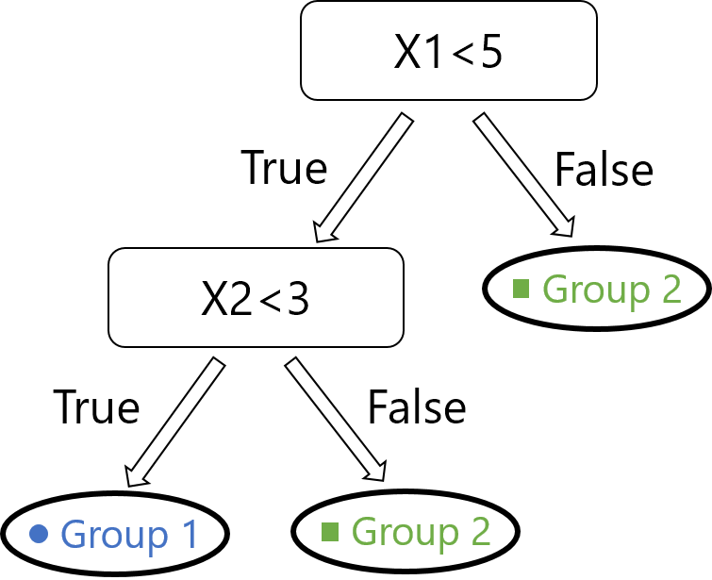
Recursive Partitioning and Impurity
Notes:
Guidelines
Use a title slide at the beginning of your presentation. There are 9 variations of title slides to choose from.
If you will have a series of slideshows, we recommend using the same style of title slide for each presentation.
Keep your title to no more than 2 lines.
Do not change the font style or font size of the title or subtitle.

Slide 3
Trees are Rules-Based Algorithms
Goal: Classify or predict an outcome based on a set of predictors
Example of Rule for Tree Below:
1) IF (X1 < 5) AND (X2 < 3) THEN Class = “Group 1”
2) IF (X1 < 5) AND (X2 >= 3) THEN Class = “Group 2”
3) IF (X1 >= 5) THEN Class = “Group 2”

Slide 4
Decision Trees
Also called CART, Decision Trees, or just Trees
Rules are represented by tree diagrams, but internally coded as rules (IF … THEN … ELSE)
Predictions are the most common class in the node

Slide 5
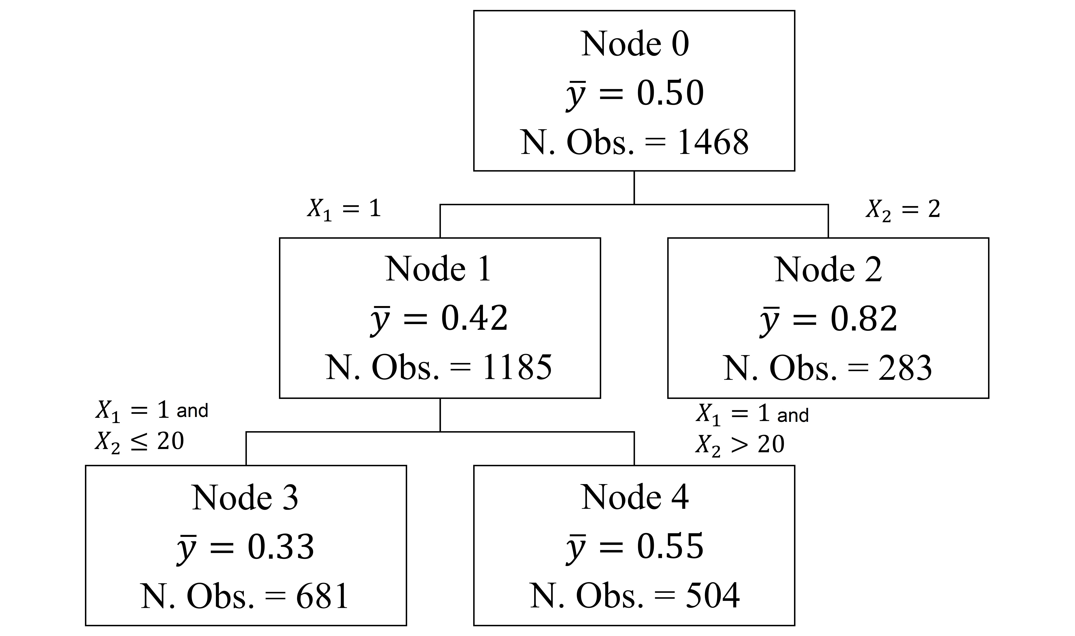
Regression Trees
Also called decision tree regressors
Also use rules
Rules are represented by tree diagrams
Predictions are the averages of the node
1) IF (X1 = 1) AND X2 <= 20 THEN prediction = 0.33
2) IF (X2 = 1) AND (X2 > 20) THEN prediction = 0.55
3) IF (X2 = 2) THEN prediction = 0.82

Slide 6
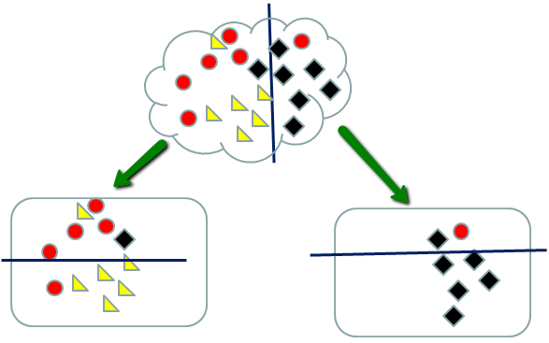
Recursive Partitioning
Repeatedly split the nodes into two parts to decrease impurity
Stop when no more impurity or stopping rule triggered

Slide 7
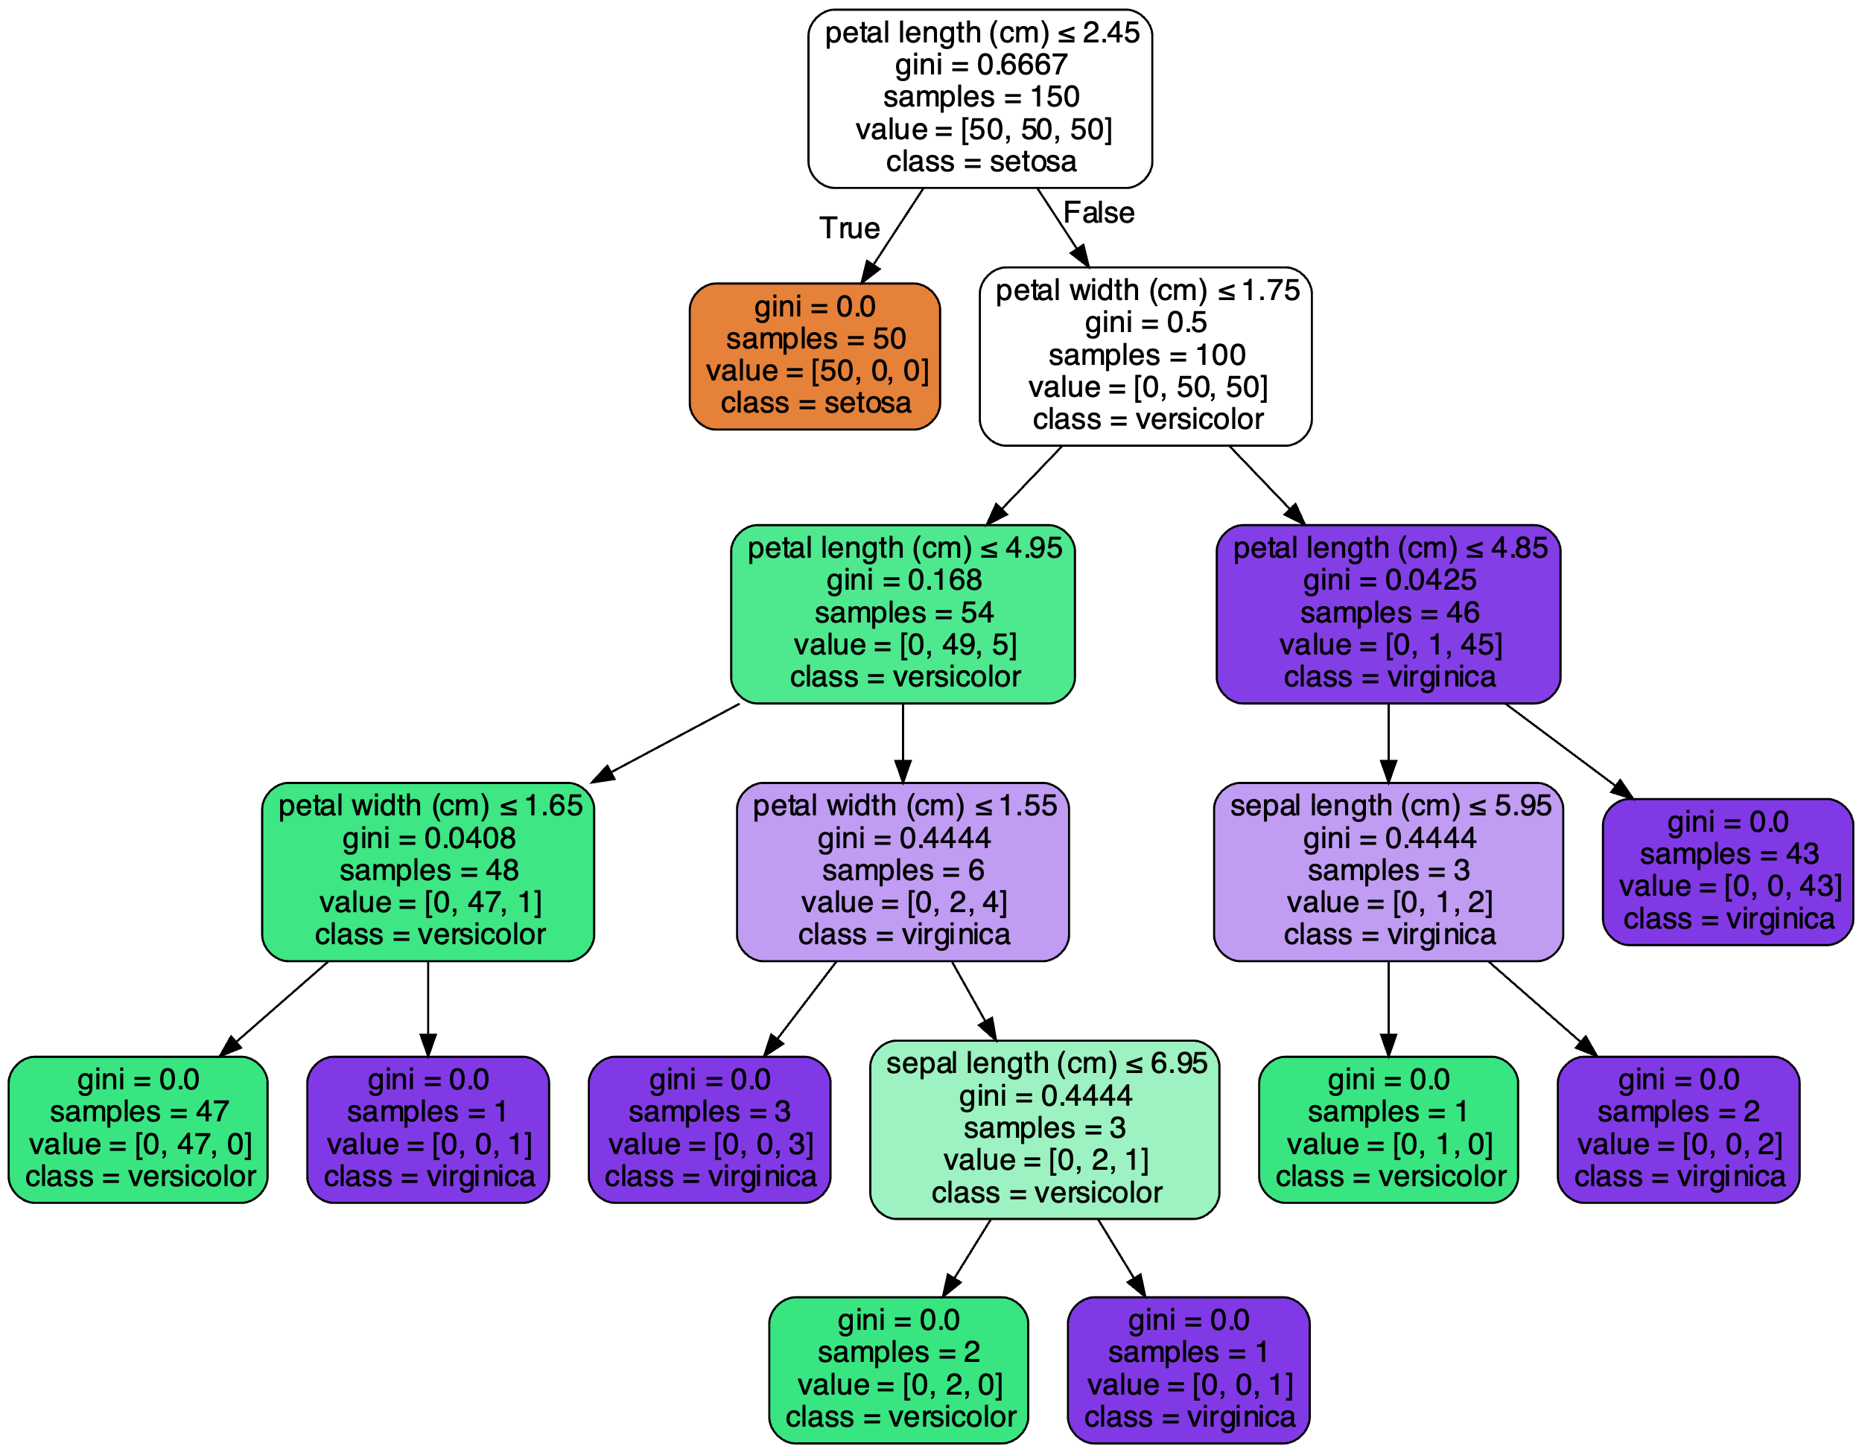
Recursive Partitioning
Terminal Node
or
Leaf
Root Node
Decision Node
Predictions are obtained in the terminal nodes as the fraction of the class of interest divided by the total number of observations.
Depth = 5, number of terminal nodes (leaves) = 9

Slide 8
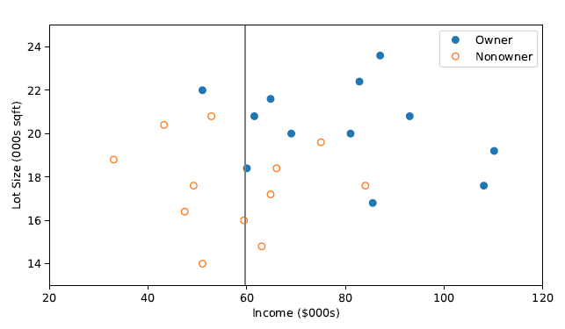
How to Measure Impurity
There are some metrics we can use
Gini Index (Classification)
Entropy (Classification)
RMSE (Regression)
These metrics are computed at each node for ALL possible splits

Slide 9
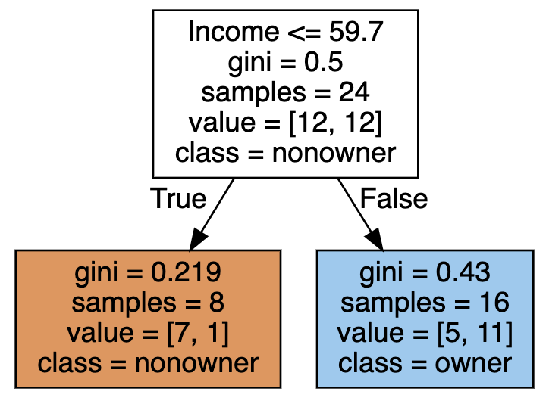
How to Measure Impurity
There are some metrics we can use
Gini Index (Classification)
Entropy (Classification)
RMSE (Regression)
These metrics are computed at each node for ALL possible splits

Slide 10
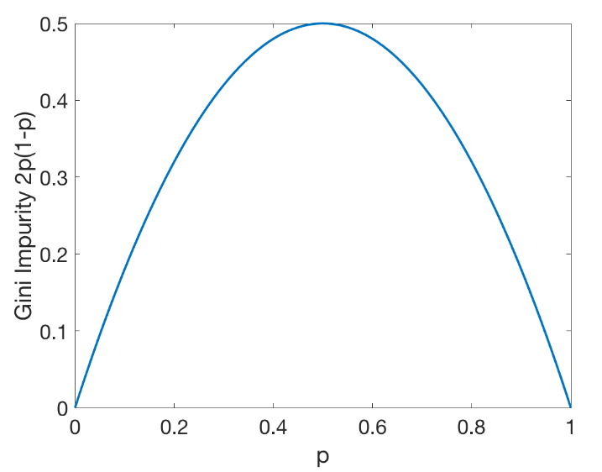
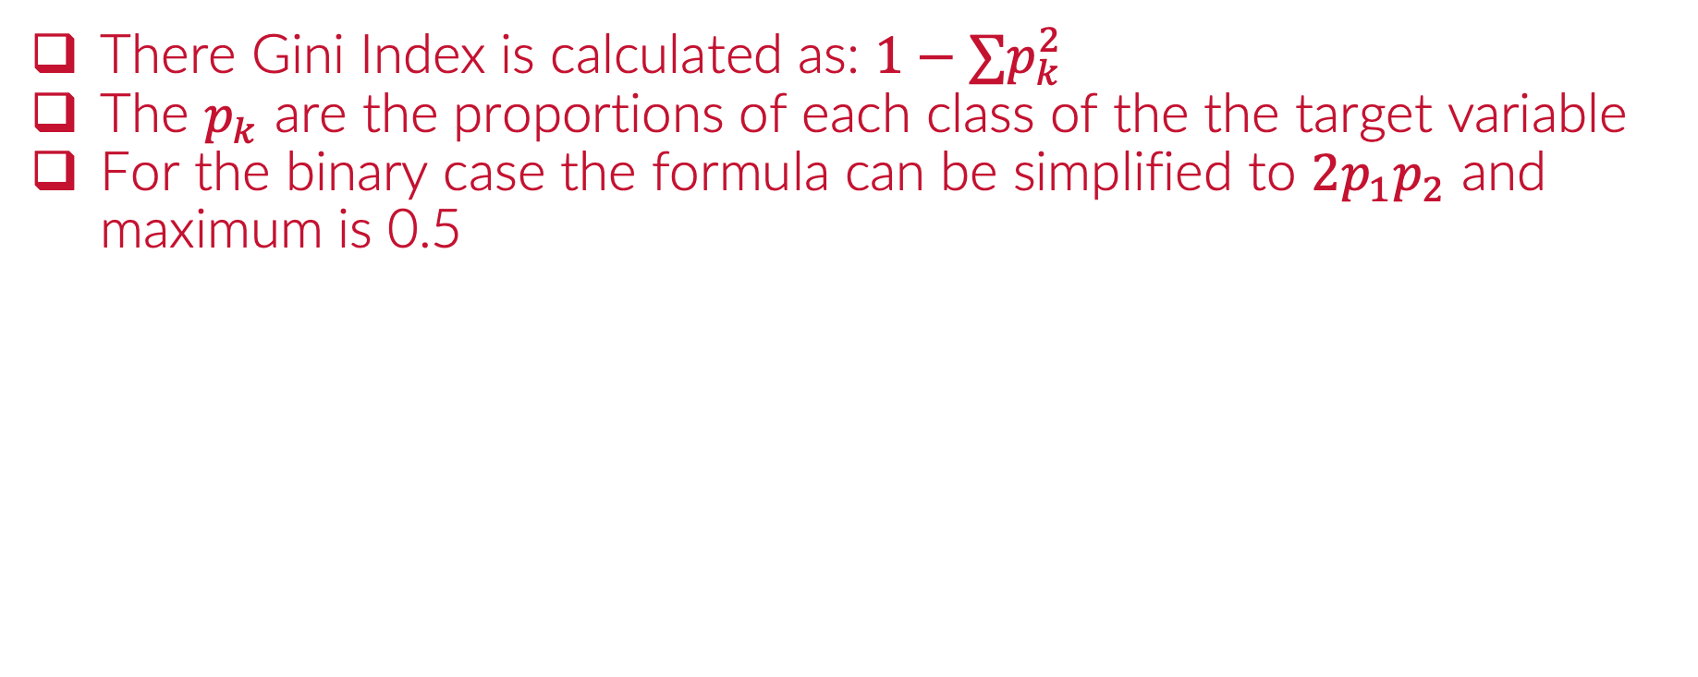
The Gini Index (Classification)
There Gini Index is calculated as: $1−∑p_{k}^{2}$
The $p_{k}$ are the proportions of each class of the the target variable
For the binary case the formula can be simplified to $2p_{1}p_{2}$ and maximum is 0.5

Slide 11
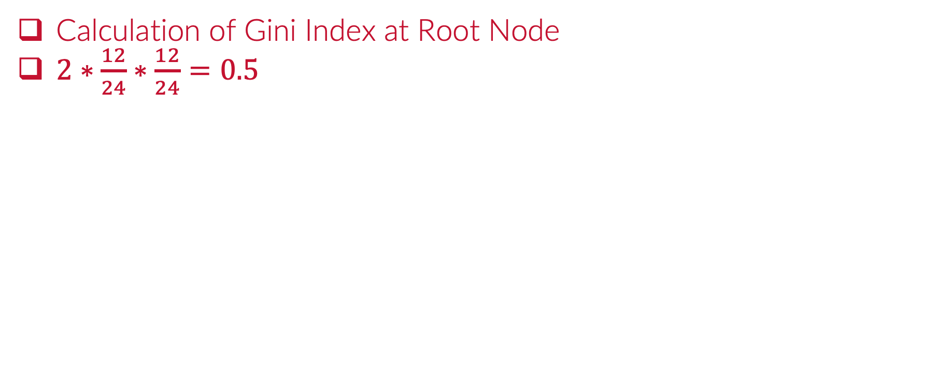
The Gini Index (Root Node)
Calculation of Gini Index at Root Node
$2∗\frac{12}{24}∗\frac{12}{24}=0.5$

Slide 12
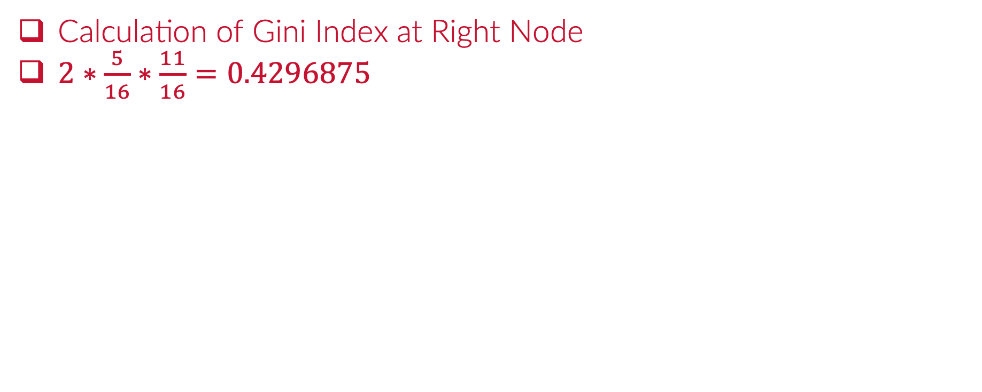
The Gini Index (Right Node)
Calculation of Gini Index at Right Node
$2∗\frac{5}{16}∗\frac{11}{16}=0.4296875$

Slide 13
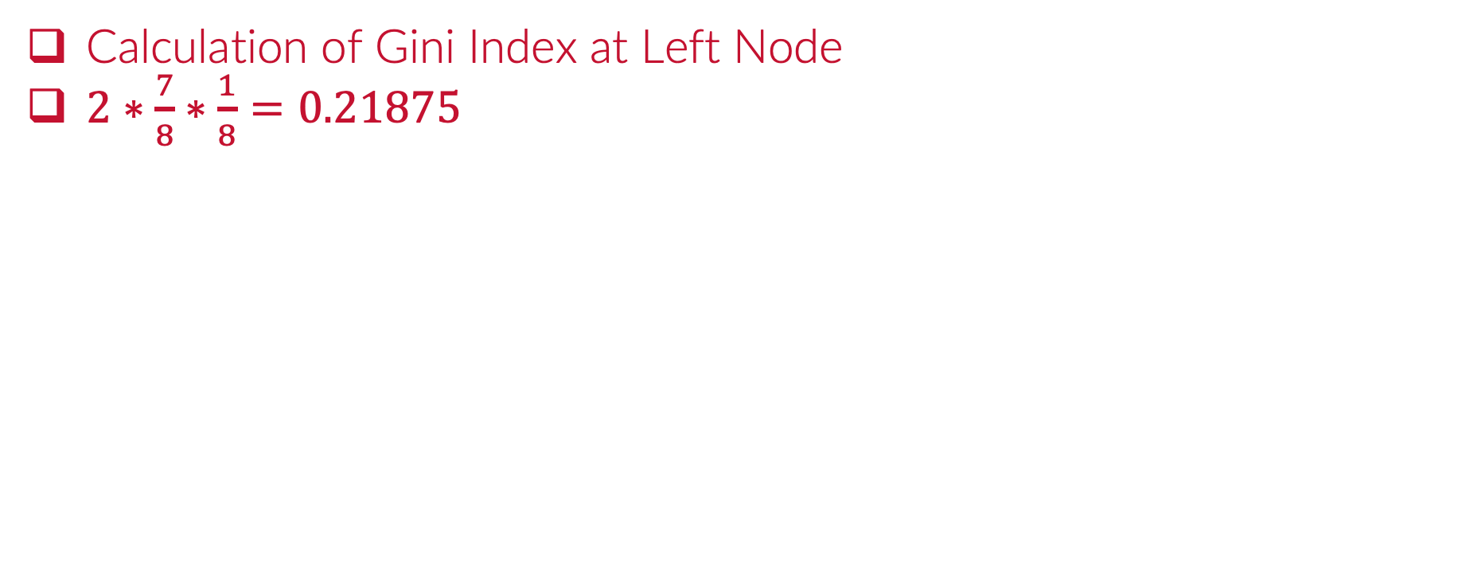
The Gini Index (Left Node)
Calculation of Gini Index at Left Node
$2∗\frac{7}{8}∗\frac{1}{8}=0.21875$

Slide 14
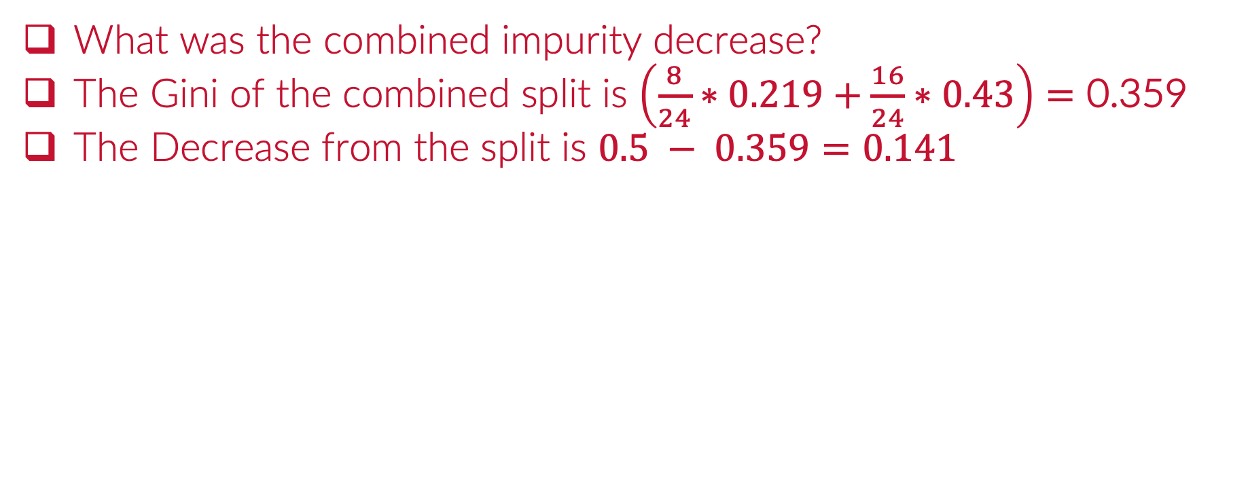
The Gini Index (Combined Split)
What was the combined impurity decrease?
The Gini of the combined split is $\left(\frac{8}{24}∗0.219+\frac{16}{24}∗0.43\right)=\text{0.359}$
The Decrease from the split is $0.5 − 0.359=0.141$

Slide 15
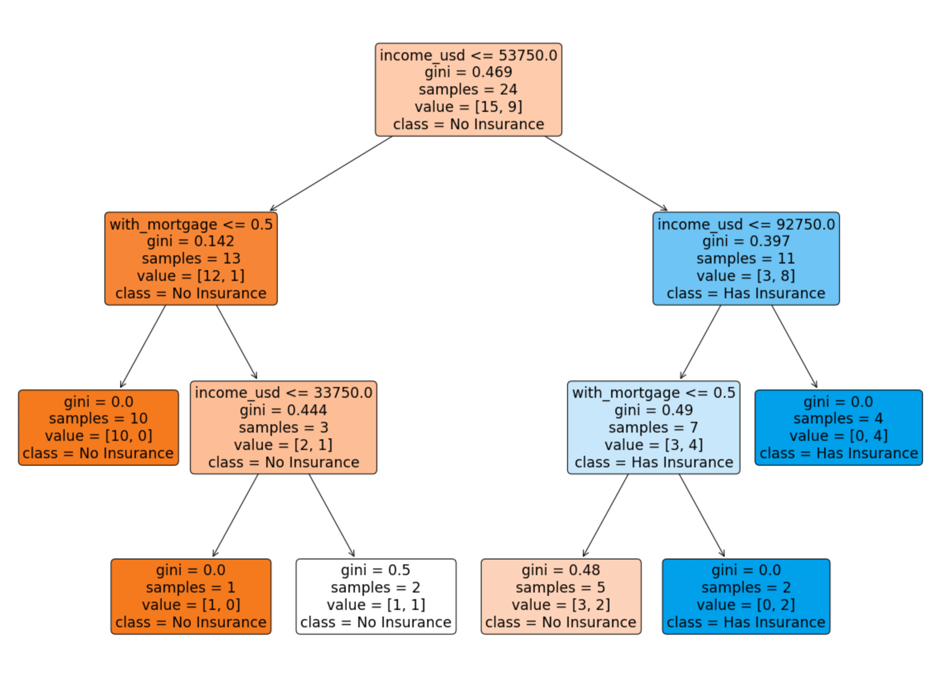
Example 1:
What is the Gini improvement from root node to the first partition?

Slide 16
Example 1:
What is the Gini improvement from root node to the first partition?

Slide 17
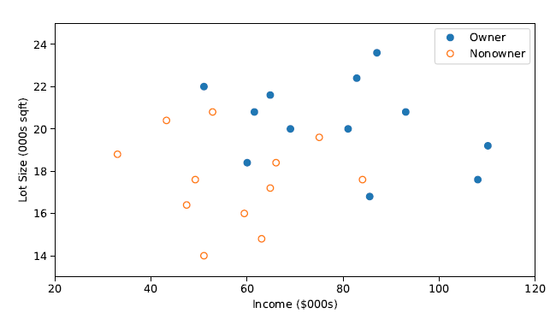
The Gini Index
These Gini Index is computed at each node for ALL possible splits

Slide 18
The Gini Index
These Gini Index is computed at each node for ALL possible splits

Slide 19
The Gini Index
These Gini Index is computed at each node for ALL possible splits

Slide 20
The Gini Index
These Gini Index is computed at each node for ALL possible splits

Slide 21
The Gini Index
These Gini Index is computed at each node for ALL possible splits

Slide 22
The Gini Index
These Gini Index is computed at each node for ALL possible splits

Slide 23
The Gini Index
These Gini Index is computed at each node for ALL possible splits

Slide 24
The Gini Index
These Gini Index is computed at each node for ALL possible splits

Slide 25
The Gini Index
These Gini Index is computed at each node for ALL possible splits

Slide 26
The Gini Index
These Gini Index is computed at each node for ALL possible splits

Slide 27
The Gini Index
These Gini Index is computed at each node for ALL possible splits

Slide 28
The Gini Index
These Gini Index is computed at each node for ALL possible splits

Slide 29
The Gini Index
These Gini Index is computed at each node for ALL possible splits

Slide 30
The Gini Index
These Gini Index is computed at each node for ALL possible splits

Slide 31
The Gini Index
These Gini Index is computed at each node for ALL possible splits

Slide 32
The Gini Index
These Gini Index is computed at each node for ALL possible splits

Slide 33
The Gini Index
These Gini Index is computed at each node for ALL possible splits

Slide 34
The Gini Index
These Gini Index is computed at each node for ALL possible splits
$$Gini Index Improvement 0.141$$

Slide 35
Python
Notes:
Guidelines
Use a title slide at the beginning of your presentation. There are 9 variations of title slides to choose from.
If you will have a series of slideshows, we recommend using the same style of title slide for each presentation.
Keep your title to no more than 2 lines.
Do not change the font style or font size of the title or subtitle.

Slide 36
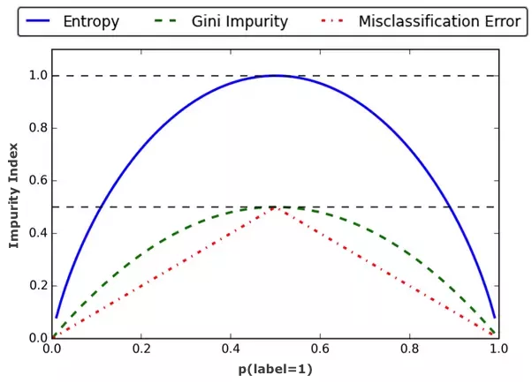
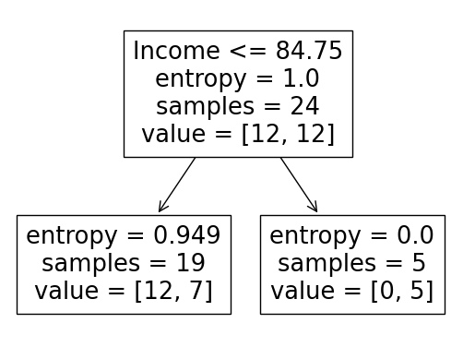
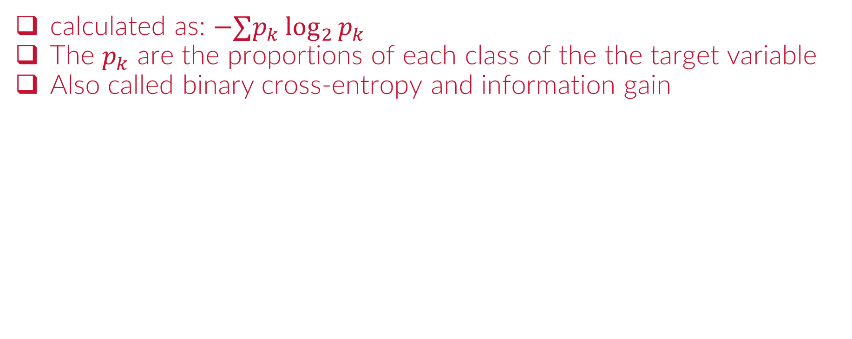
The Entropy (Classification)
calculated as: $−∑p_{k}\log_{2}{p_{k}}$
The $p_{k}$ are the proportions of each class of the the target variable
Also called binary cross-entropy and information gain

Slide 37
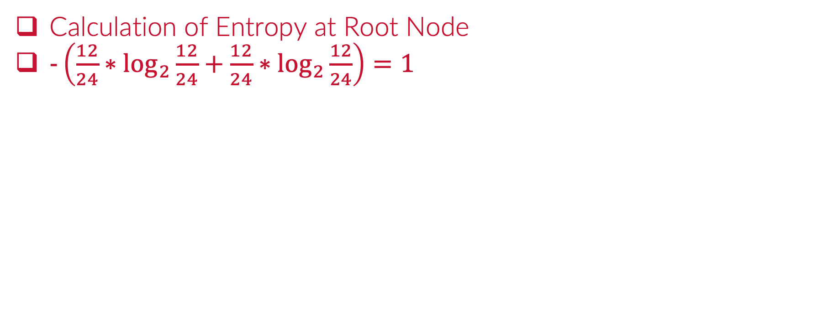
The Entropy (Root Node)
Calculation of Entropy at Root Node
$−\left(\frac{12}{24}∗\log_{2}{\frac{12}{24}}+\frac{12}{24}∗\log_{2}{\frac{12}{24}}\right)=1$

Slide 38
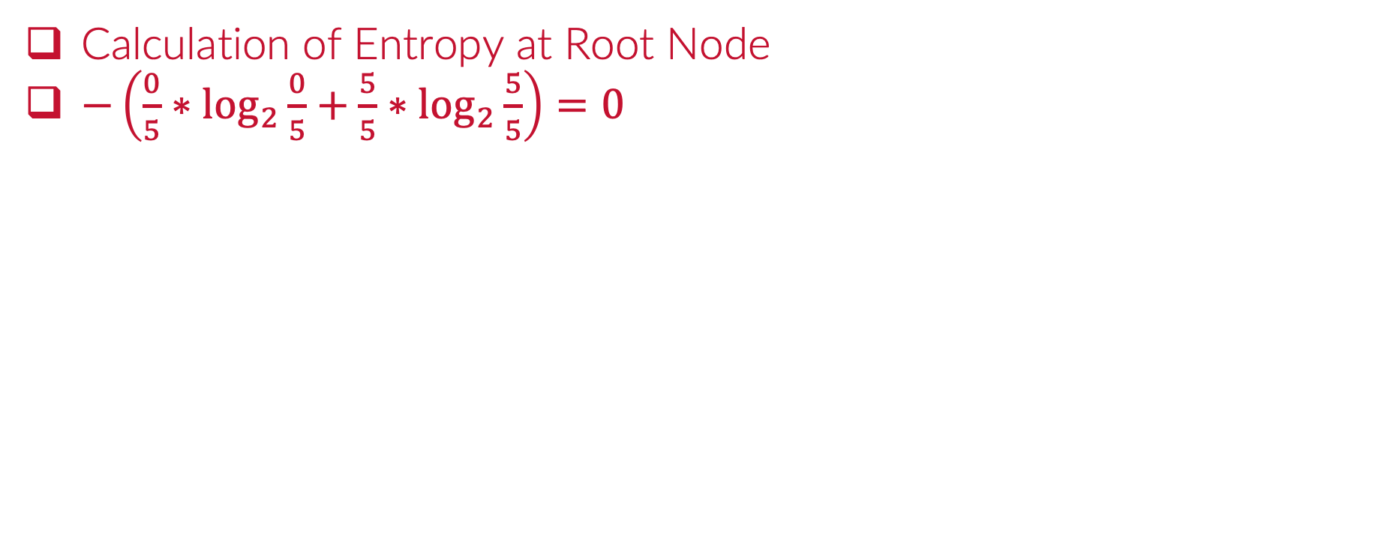
The Entropy (at Right Node)
Calculation of Entropy at Root Node
$−\left(\frac{0}{5}∗\log_{2}{\frac{0}{5}}+\frac{5}{5}∗\log_{2}{\frac{5}{5}}\right)=0$

Slide 39
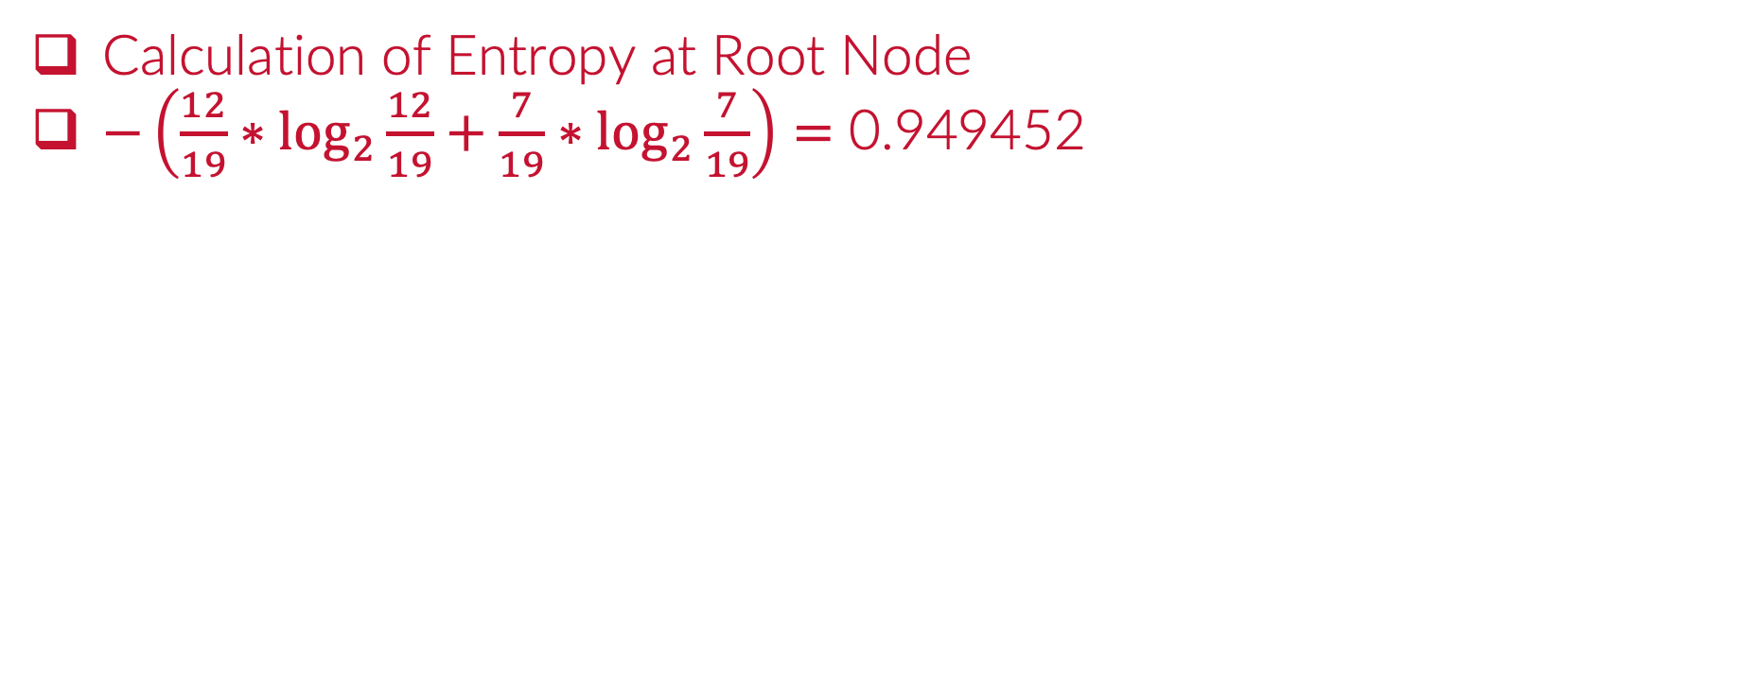
The Entropy (at Left Node)
Calculation of Entropy at Root Node
$−\left(\frac{12}{19}∗\log_{2}{\frac{12}{19}}+\frac{7}{19}∗\log_{2}{\frac{7}{19}}\right)=\text{0.949452}$

Slide 40
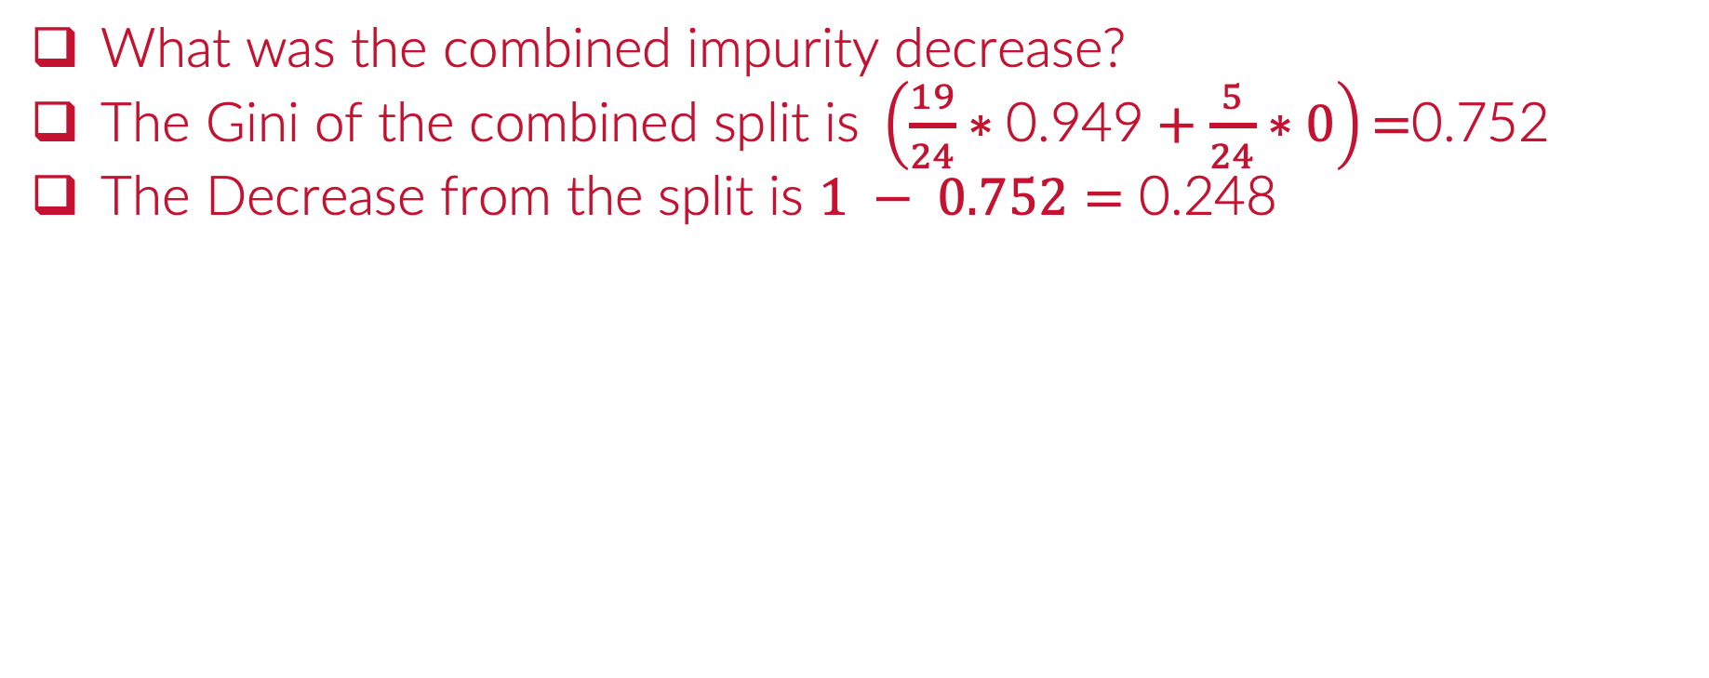
The Entropy (Combined Split)
$\text{What} \text{was} \text{the} \text{combined} \text{impurity} \text{decrease}\text{?}$
$\text{The} \text{Gini} \text{of} \text{the} \text{combined} \text{split} \text{is} \left(\frac{19}{24}∗\text{0.949}+\frac{5}{24}∗0\right)\text{=}\text{0.75}\text{2 }$
$\text{The} \text{Decrease} \text{from} \text{the} \text{split} \text{is} 1 − 0.752=\text{0.248}$

Slide 41
The Entropy
The Entropy is computed at each node for ALL possible splits
$$Entropy Improvement 0.248$$

Slide 42
Python
Notes:
Guidelines
Use a title slide at the beginning of your presentation. There are 9 variations of title slides to choose from.
If you will have a series of slideshows, we recommend using the same style of title slide for each presentation.
Keep your title to no more than 2 lines.
Do not change the font style or font size of the title or subtitle.

Slide 43
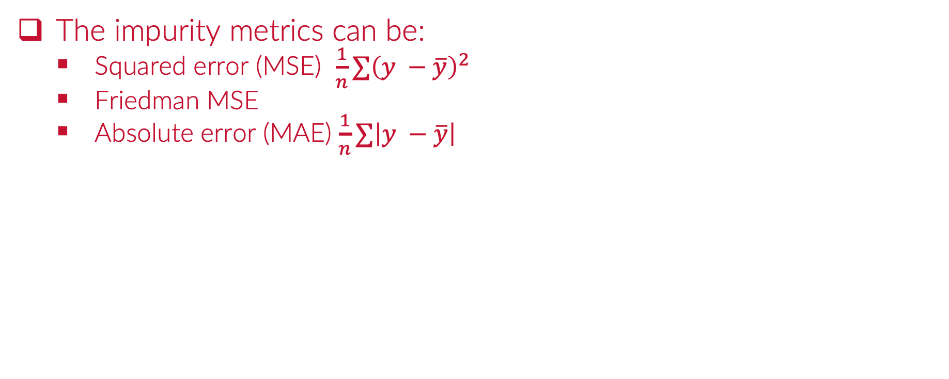
Regression Trees
The impurity metrics can be:
Squared error (MSE) $\frac{1}{n}∑{\left(y −\overline{y}\right)}^{2}$
Friedman MSE
Absolute error (MAE) $\frac{1}{n}∑\left|y −\overline{y}\right|$
1) IF (X1 = 1) AND X2 <= 20 THEN prediction = 0.33
2) IF (X2 = 1) AND (X2 > 20) THEN prediction = 0.55
3) IF (X2 = 2) THEN prediction = 0.82

Slide 44
Python
Notes:
Guidelines
Use a title slide at the beginning of your presentation. There are 9 variations of title slides to choose from.
If you will have a series of slideshows, we recommend using the same style of title slide for each presentation.
Keep your title to no more than 2 lines.
Do not change the font style or font size of the title or subtitle.

Slide 45
Hyperparameters
Notes:
Guidelines
Use a title slide at the beginning of your presentation. There are 9 variations of title slides to choose from.
If you will have a series of slideshows, we recommend using the same style of title slide for each presentation.
Keep your title to no more than 2 lines.
Do not change the font style or font size of the title or subtitle.

Slide 46
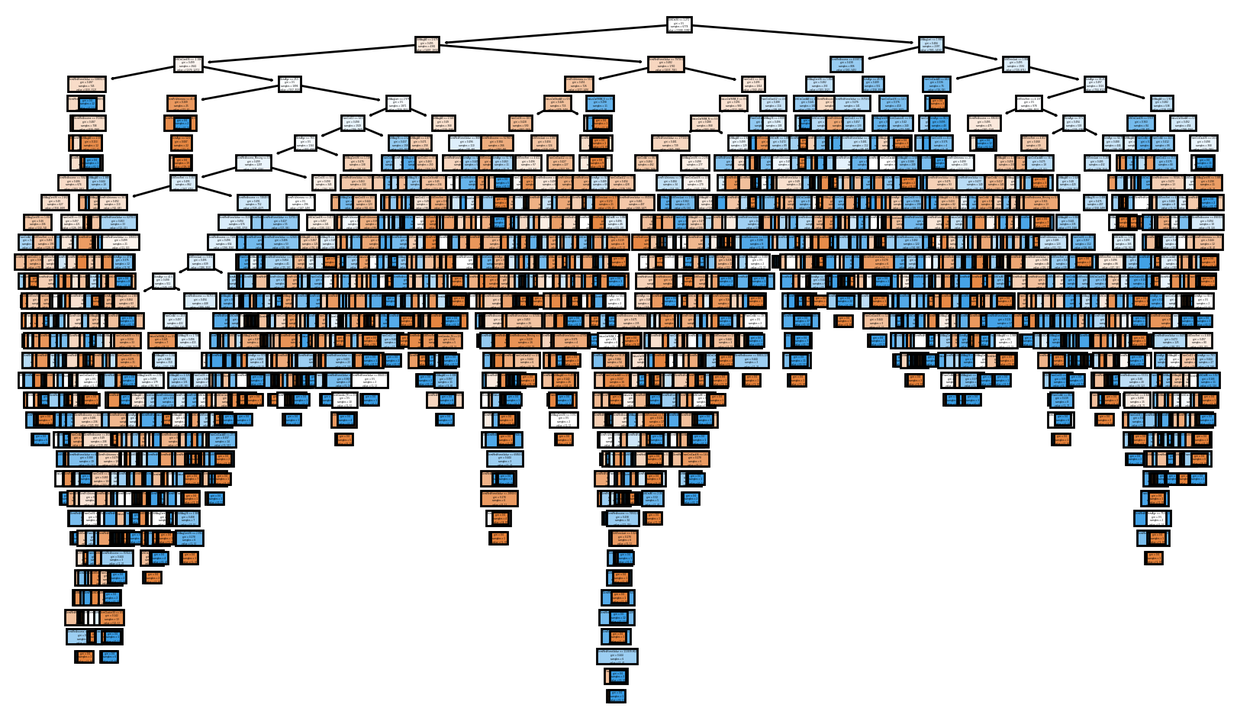
Hyperparameters
Model parameters whose value are used to control the model.
Mostly used to control tree growth (stopping criteria)

Slide 47
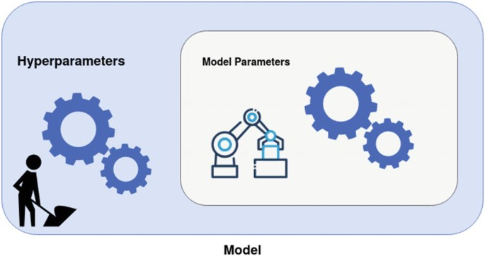
Hyperparameters vs Parameters
The estimates of slopes, coefficients are referred to as parameters.
Hyperparameters are set by user prior to fitting the model.

Slide 48
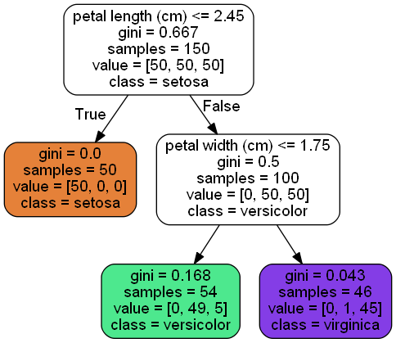
Splitting Criterion
The splitting criterion (criterion) refers to the impurity metric.
Classification
Gini Index
Entropy
Regression
MSE
Friedman MSE
MAE
Poisson

Slide 49
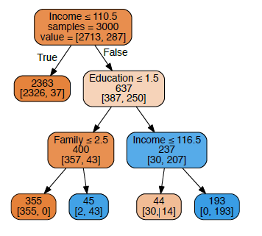
Maximum Tree Depth
How many levels a tree can go down?
We call this the depth of the tree
Depth = 1
Depth = 2
Depth = 3

Slide 50
Maximum Tree Depth
We can limit the tree growth by setting the maximum depth
max_depth = 2

Slide 51
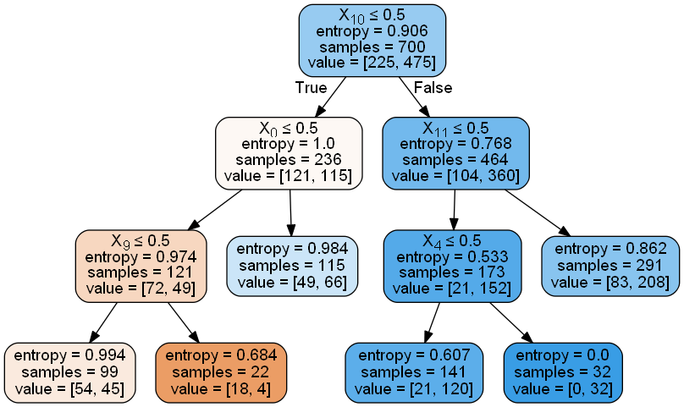
Maximum Number of Terminal Nodes
We can limit the number of leaves to a specific value
max_leaf_nodes = 6

Slide 52
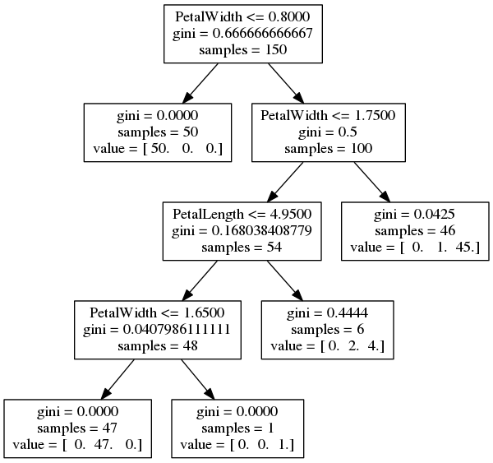
Minimum Samples
We can set a limit to number of observations needed to split node
min_sample_split = 10

Slide 53
Minimum Samples
We can set a limit to number of observations for a leaf
min_sample_leaf = 20

Slide 54
Minimum Impurity Decrease
The minimum improvement in impurity to split node
min_impurity_decrease = 0.05

Slide 55
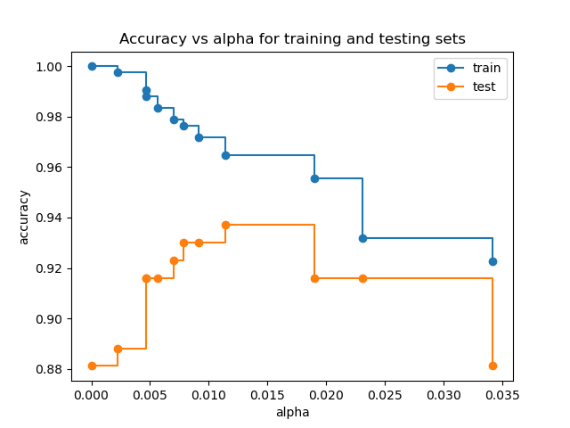
Cost Complexity Pruning
Can control pruning level based on test accuracy.
Uses alpha specifies level of pruning (higher alpha = higher pruning)

Slide 56
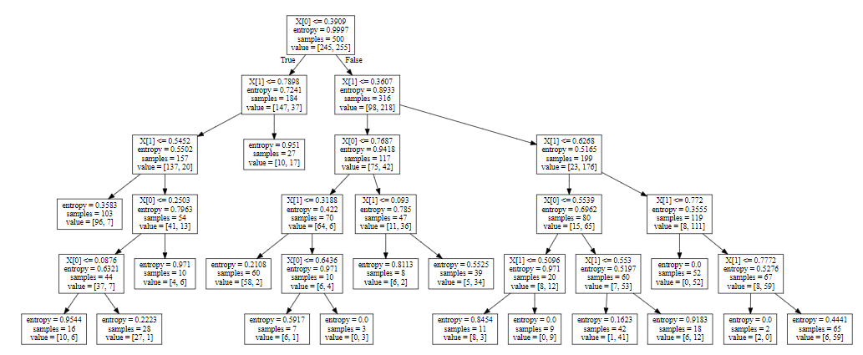
Cost Complexity Pruning
Can control pruning level based on test accuracy.
Uses alpha specifies level of pruning (higher alpha = higher pruning)

Slide 57
Python
Notes:
Guidelines
Use a title slide at the beginning of your presentation. There are 9 variations of title slides to choose from.
If you will have a series of slideshows, we recommend using the same style of title slide for each presentation.
Keep your title to no more than 2 lines.
Do not change the font style or font size of the title or subtitle.

Slide 58

Cross-Validation
Resampling method that uses different portions of the data to test and train a model on different iterations.

Slide 59
Cross-Validation
Resampling method that uses different portions of the data to test and train a model on different iterations.
check model
performance
fit

Slide 60
Cross-Validation
Resampling method that uses different portions of the data to test and train a model on different iterations.
check model
performance
Fit
Fit

Slide 61
Cross-Validation
Resampling method that uses different portions of the data to test and train a model on different iterations.
check model
performance
Fit
Fit

Slide 62
Cross-Validation
Resampling method that uses different portions of the data to test and train a model on different iterations.
check model
performance
Fit
Fit

Slide 63
Cross-Validation
Resampling method that uses different portions of the data to test and train a model on different iterations.
check model
performance
Fit

Slide 64
Cross-Validation
Resampling method that uses different portions of the data to test and train a model on different iterations.
Average the test performances
score: for classification accuracy_score

Slide 65
Python
Notes:
Guidelines
Use a title slide at the beginning of your presentation. There are 9 variations of title slides to choose from.
If you will have a series of slideshows, we recommend using the same style of title slide for each presentation.
Keep your title to no more than 2 lines.
Do not change the font style or font size of the title or subtitle.

Slide 66
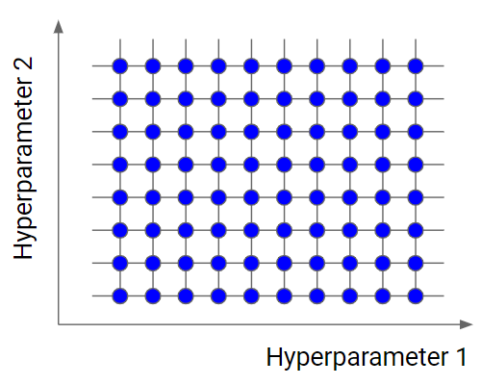
Grid Search
involves searching through a range of values for hyperparameters to find the best subset

Slide 67
Grid Search
involves searching through a range of values for hyperparameters to find the best subset
criterion = {‘gini’, ‘entropy’}
max_depth = {2,3,4,5}
min_impurity_decrease = {0, 0.01, 0.05, 0.1}

Slide 68
Grid Search
involves searching through a range of values for hyperparameters to find the best subset
1) Set the grid with initial guess for parameters
2) Fit model with grid search
3) Repeat process until best model is found.

Slide 69
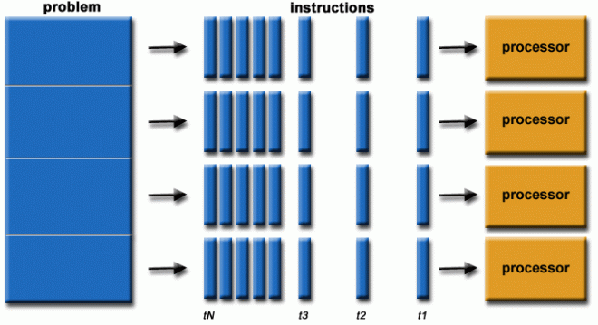
Grid Search – Parallel Processing
Involves dividing the work into multiple processor units
CV uses multiple fits of the model that can be done separately

Slide 70
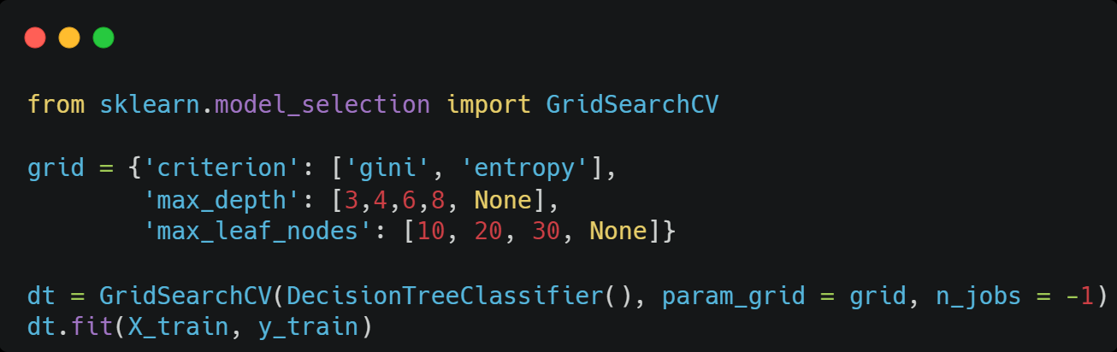
Grid Search – Coding on sklearn
Create grid using a dictionary
Use model as an input to the GridSearchCV algorithm
Use parallel processing to speed up

Slide 71
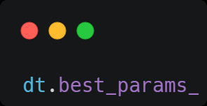
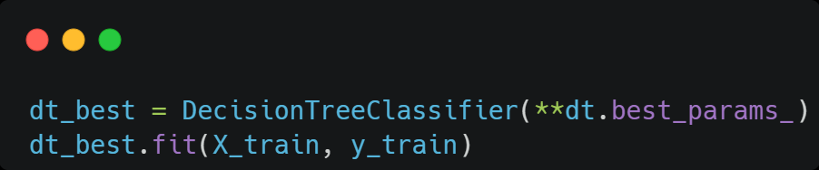
Grid Search – Coding on sklearn
The best parameters can be found after fit.
You can re-fit with these parameters:
Alternatively, you can use the GridSearchCV fit as your model

Slide 72
Python
Notes:
Guidelines
Use a title slide at the beginning of your presentation. There are 9 variations of title slides to choose from.
If you will have a series of slideshows, we recommend using the same style of title slide for each presentation.
Keep your title to no more than 2 lines.
Do not change the font style or font size of the title or subtitle.

Slide 73

Ensembles
Notes:
Guidelines
Use a title slide at the beginning of your presentation. There are 9 variations of title slides to choose from.
If you will have a series of slideshows, we recommend using the same style of title slide for each presentation.
Keep your title to no more than 2 lines.
Do not change the font style or font size of the title or subtitle.

Slide 74
Findings on Decision Trees
Are easily overfit to the sample used
Performance hard to judge on a single training and validation sample.
Decision Trees Have Low Bias, High Variance

Slide 75
Findings on Decision Trees
Are easily overfit to the sample used
Performance hard to judge on a single training and validation sample.
Decision Trees Have Low Bias, High Variance

Slide 76
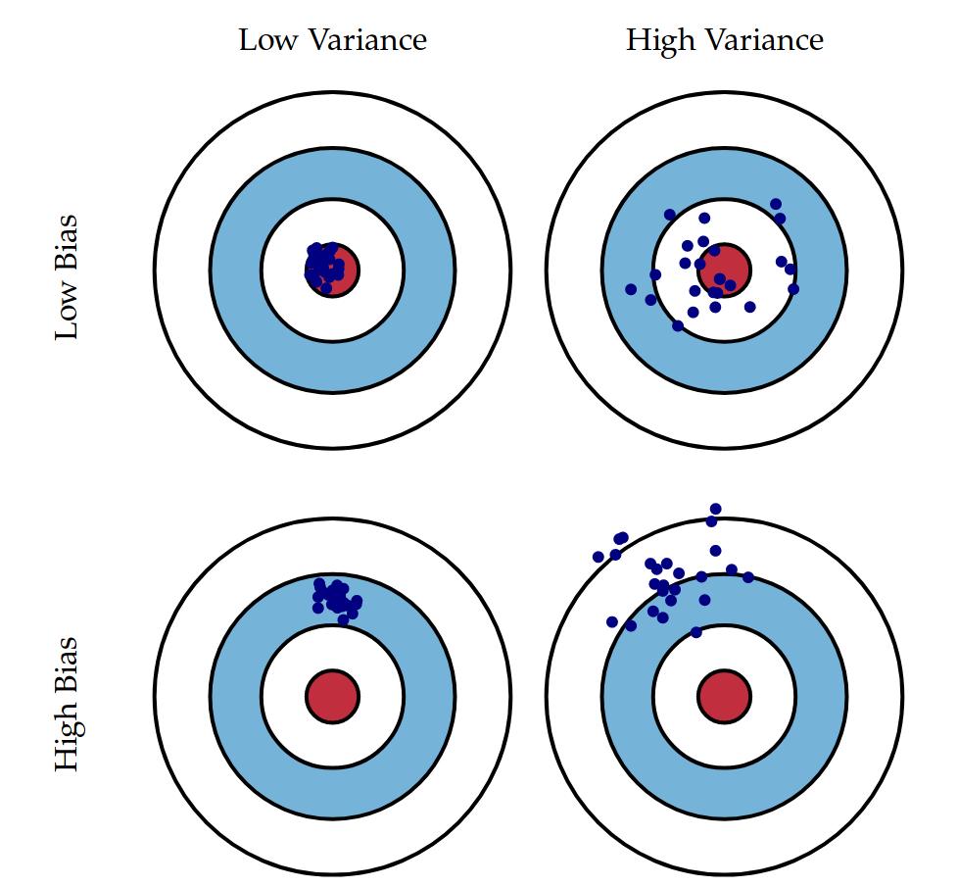
Bias vs Variance

Slide 77
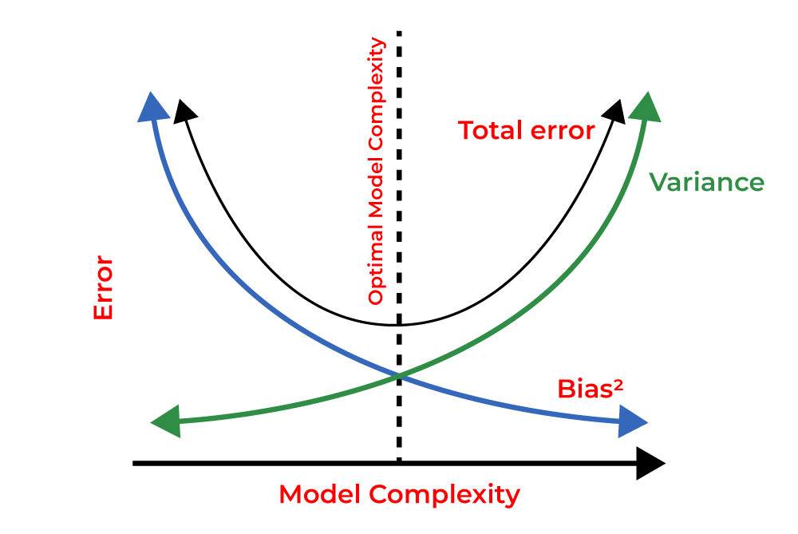
Bias vs Variance

Slide 78
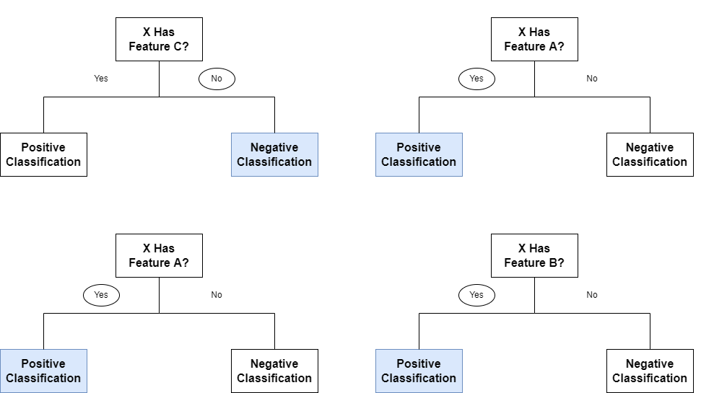
Ensemble Models
Combine the predictions from different tree models ( variance).
We are using a more complex model ( bias).

Slide 79
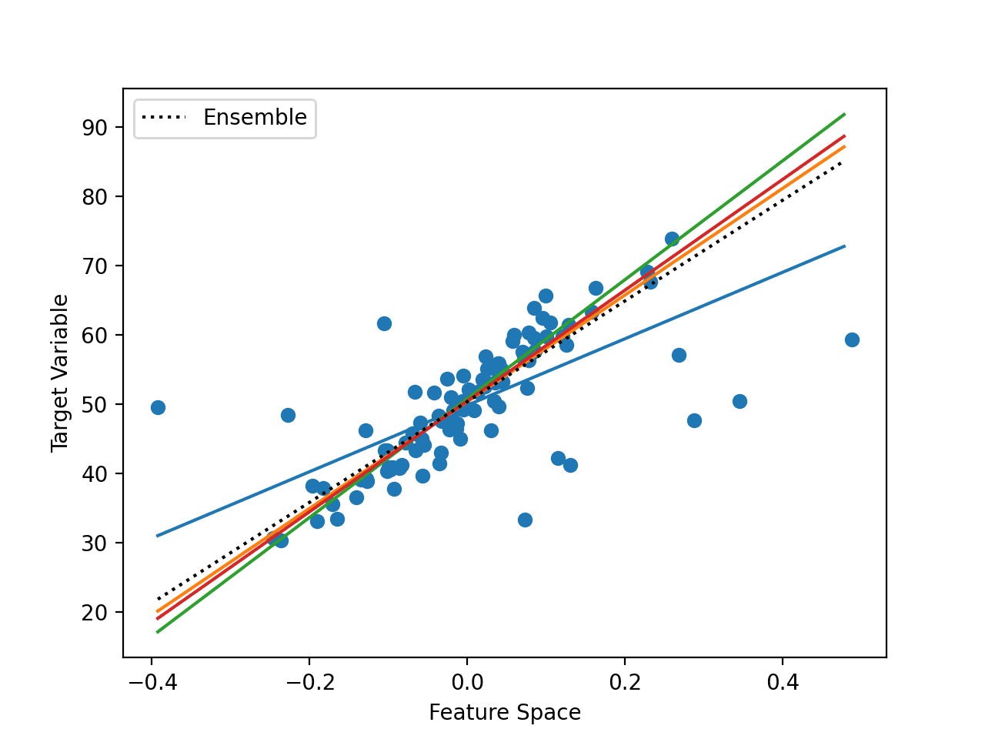
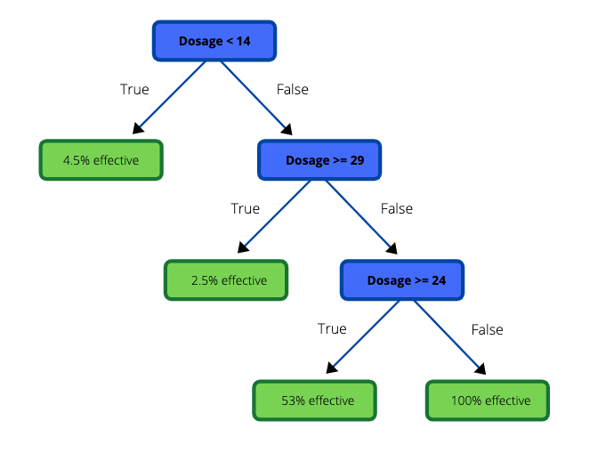
Ensemble Models for Regression
Combine the predictions from different tree models ( variance).
We are using a more complex model ( bias).

Slide 80
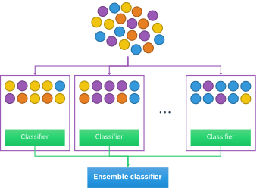
Bagging
Notes:
Guidelines
Use a title slide at the beginning of your presentation. There are 9 variations of title slides to choose from.
If you will have a series of slideshows, we recommend using the same style of title slide for each presentation.
Keep your title to no more than 2 lines.
Do not change the font style or font size of the title or subtitle.

Slide 81
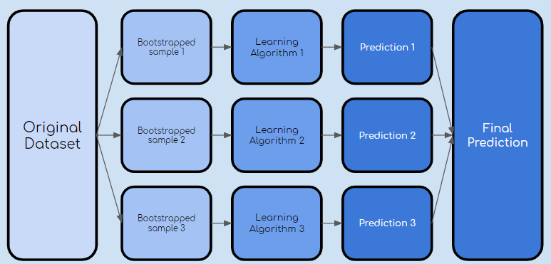
Bootstrap Aggregating (Bagging)
Bootstrapping means to randomly sample with replacement
A bootstrap sample is the same size as the original data set.

Slide 82
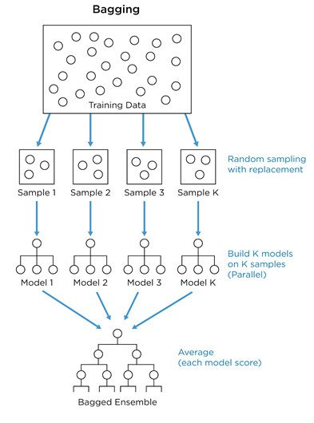
Bootstrap Aggregating (Bagging)
Bootstrapping means to randomly sample with replacement
A bootstrap sample is the same size as the original data set.

Slide 83
Bootstrap Aggregating (Bagging)
The out of bag (OOB) score can help estimate performance
Observations not selected in the bootstrap sample can be used to estimate the performance of the ensemble: Out-of-bag Performance.

Slide 84
Bootstrap Aggregating (Bagging)
Important hyper-parameter : number of estimators

Slide 85
Python
Notes:
Guidelines
Use a title slide at the beginning of your presentation. There are 9 variations of title slides to choose from.
If you will have a series of slideshows, we recommend using the same style of title slide for each presentation.
Keep your title to no more than 2 lines.
Do not change the font style or font size of the title or subtitle.

Slide 86
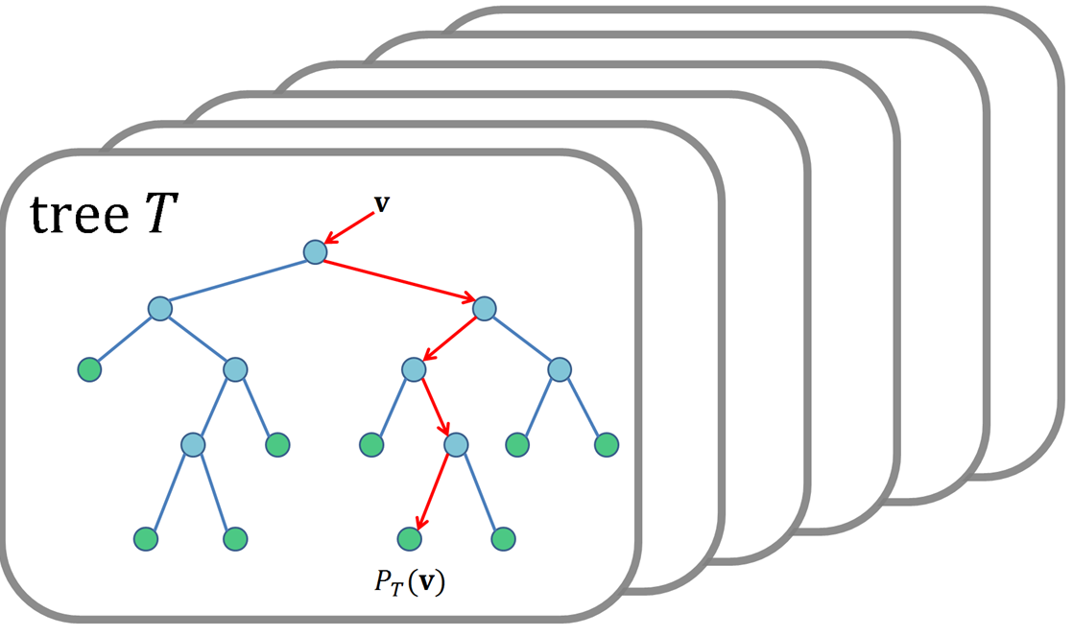
Random Forests
Notes:
Guidelines
Use a title slide at the beginning of your presentation. There are 9 variations of title slides to choose from.
If you will have a series of slideshows, we recommend using the same style of title slide for each presentation.
Keep your title to no more than 2 lines.
Do not change the font style or font size of the title or subtitle.

Slide 87
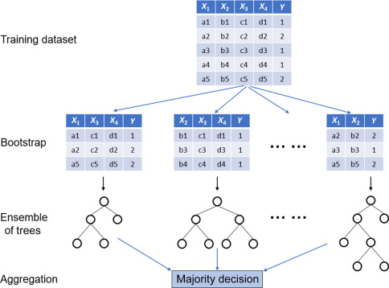
Random Forests
Bagging produces correlated predictions b/c we use same variables
We can improve Bagging by also sampling the variables

Slide 88
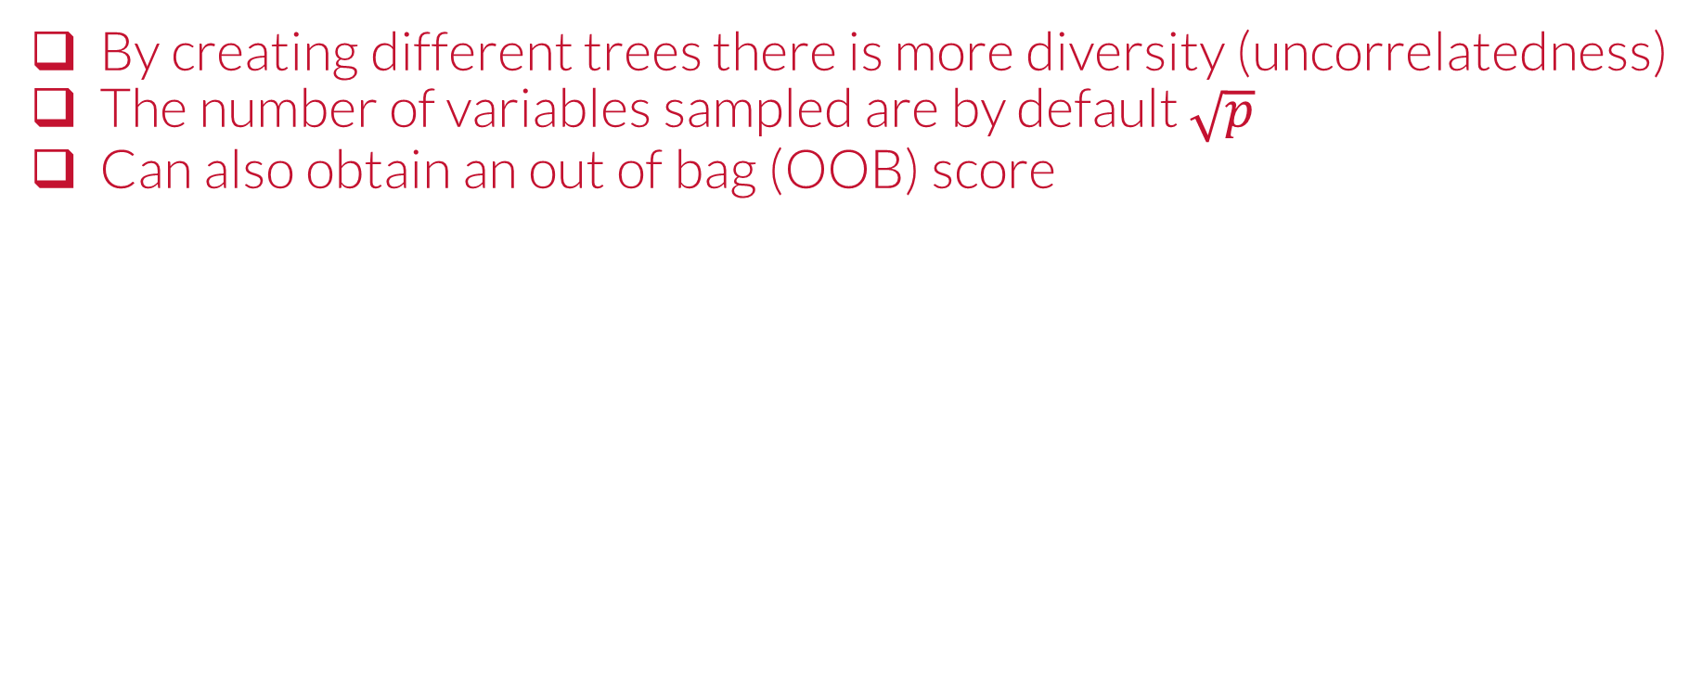
Random Forests
By creating different trees there is more diversity (uncorrelatedness)
The number of variables sampled are by default $\sqrt{p}$
Can also obtain an out of bag (OOB) score

Slide 89
Random Forests
Important Hyper-parameters: number of estimators, stopping rules, tree structure

Slide 90
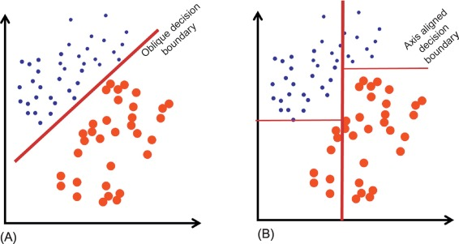
Decision (Separating) Boundaries
Partitions the vector space into sets, one for each class.

Slide 91
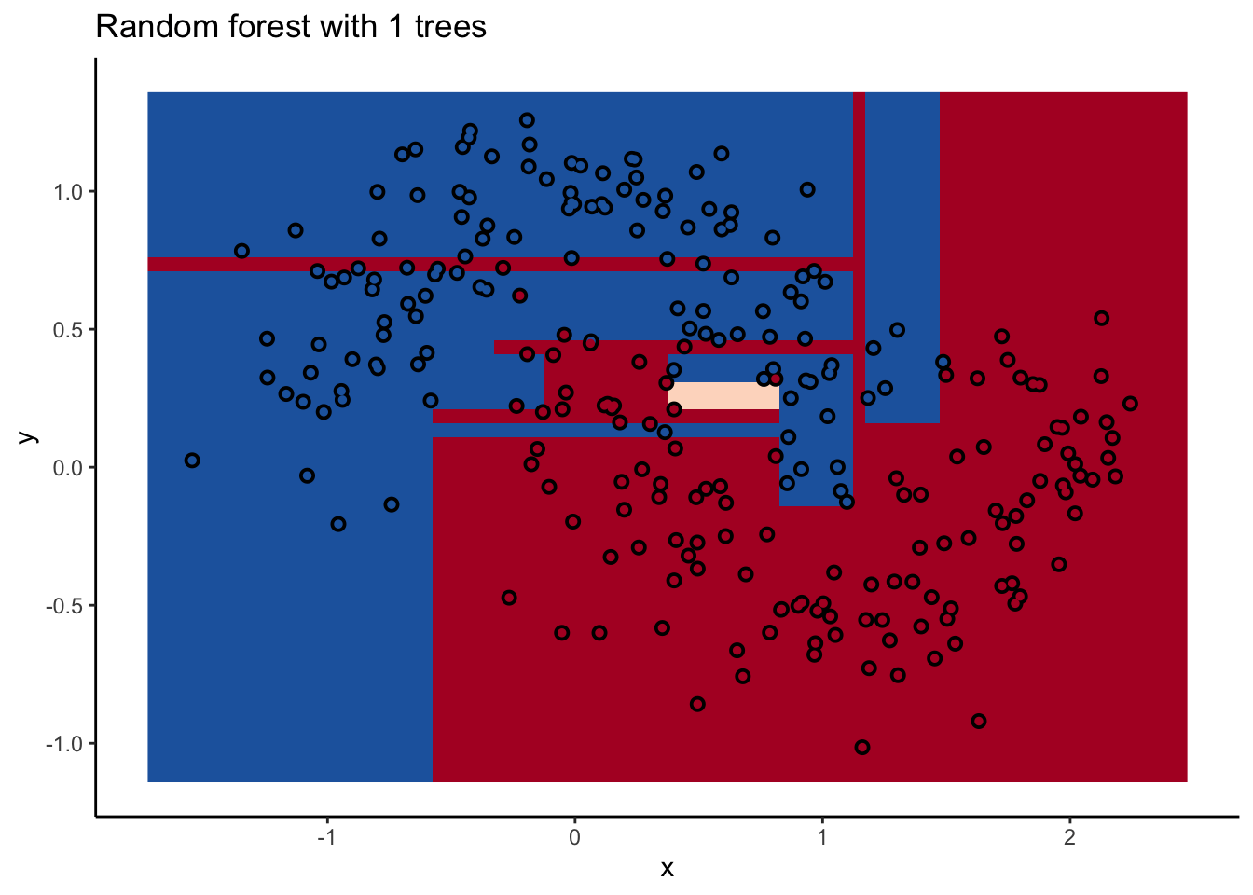
Random Forests
Decision Boundary of RF

Slide 92
Python
Notes:
Guidelines
Use a title slide at the beginning of your presentation. There are 9 variations of title slides to choose from.
If you will have a series of slideshows, we recommend using the same style of title slide for each presentation.
Keep your title to no more than 2 lines.
Do not change the font style or font size of the title or subtitle.

Slide 93
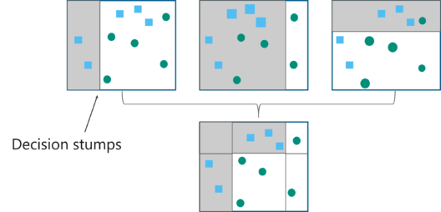
Boosting
Notes:
Guidelines
Use a title slide at the beginning of your presentation. There are 9 variations of title slides to choose from.
If you will have a series of slideshows, we recommend using the same style of title slide for each presentation.
Keep your title to no more than 2 lines.
Do not change the font style or font size of the title or subtitle.

Slide 94
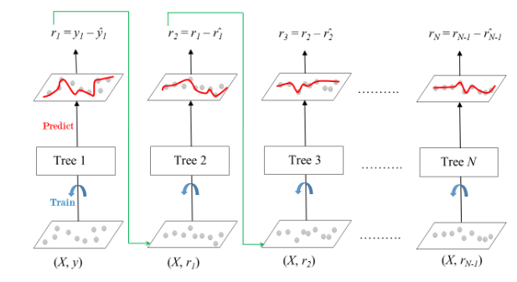
Boosted Trees (Boosting)
In boosting trees are grown sequentially.
Each tree is fit on a the residuals of the previous tree.

Slide 95

Boosted Trees (Boosting)
In boosting trees are grown sequentially.
Each tree is fit on a the residuals of the previous tree.

Slide 96

Boosted Trees (Boosting)
In boosting trees are grown sequentially.
Each tree is fit on a the residuals of the previous tree.

Slide 97
Python
Notes:
Guidelines
Use a title slide at the beginning of your presentation. There are 9 variations of title slides to choose from.
If you will have a series of slideshows, we recommend using the same style of title slide for each presentation.
Keep your title to no more than 2 lines.
Do not change the font style or font size of the title or subtitle.

Slide 98

Gradient Boosting
Gradient descent is an optimization algorithm used to minimize some function by iteratively moving in the direction of steepest descent

Slide 99

Gradient Boosting
Important hyper-parameter is the step size (learning rate)

Slide 100
Python
Notes:
Guidelines
Use a title slide at the beginning of your presentation. There are 9 variations of title slides to choose from.
If you will have a series of slideshows, we recommend using the same style of title slide for each presentation.
Keep your title to no more than 2 lines.
Do not change the font style or font size of the title or subtitle.

